Slide 1
Alksnis UD
issues

Slide 2
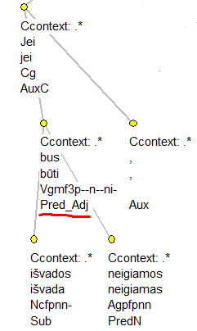
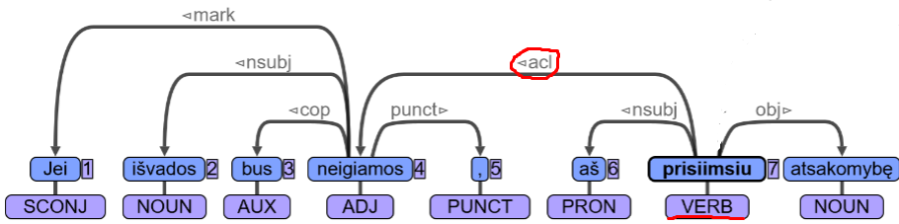
Pred_Adj acl acl advcl
If conclusions will be negative , I will take responsibility

Slide 3
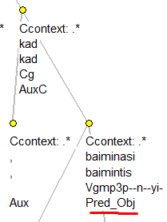
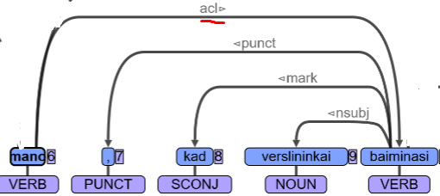
Pred_Obj acl acl ccomp
thinks that businessmen are worried

Slide 4
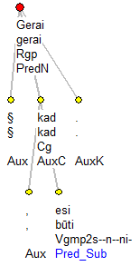
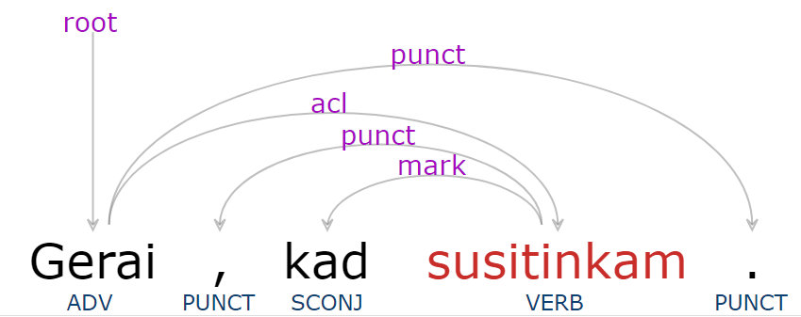
Pred_Subj acl csubj
(it’s) good , that we meet each other

Slide 5
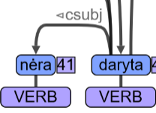
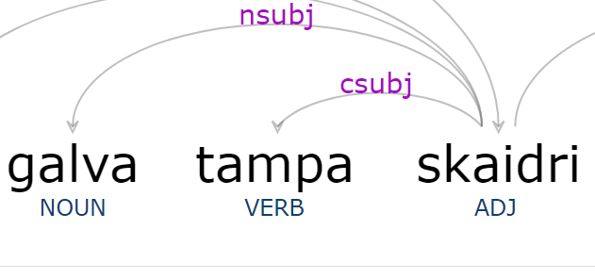
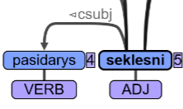
PredN csubj xcomp/aux
has not been done
head becomes clear
will become shallower

Slide 6
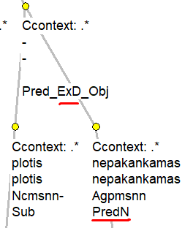
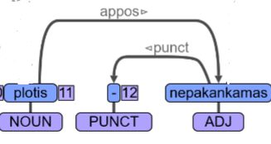
Ellipsis(omitted “to be”): _ExD
width (is) insufficient

Slide 7
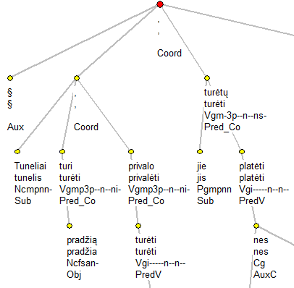
Nested coordinations

Slide 8
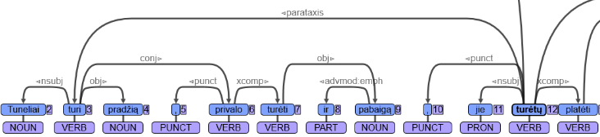
Nested coordination
Tunnels have a beginning, they should have an end too, they should broaden out

Slide 9
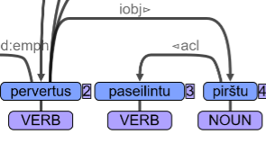
Instrumentalis as iobj?
turn (with a) licked.I finger.I

Slide 10
General issues

Slide 11
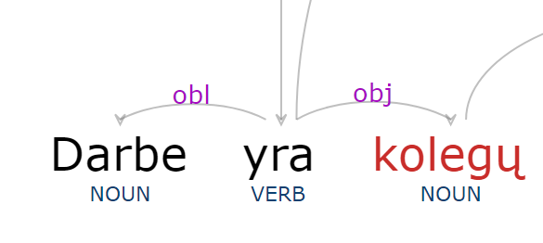
“to be” + Gen.
at work (there) are colleagues.Gen ,

Slide 12
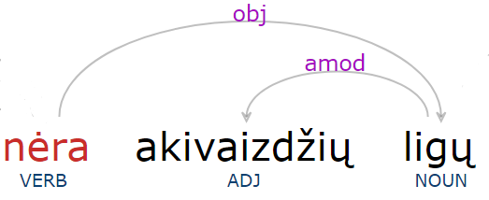
Negation + Gen.
(there) are no obvious.pl.G diseases.G

Slide 13
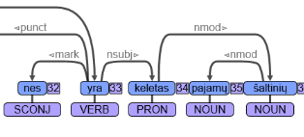
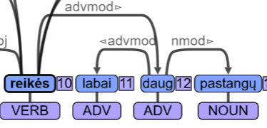
more/less/several + Gen.
because (there) are several income.pl.G sources.G
will need very much effort.pl.G

Slide 14
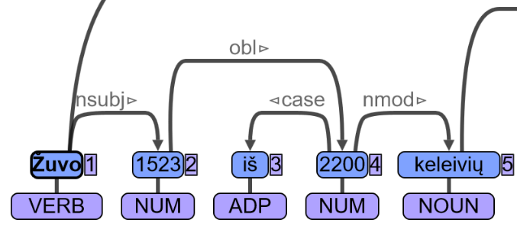
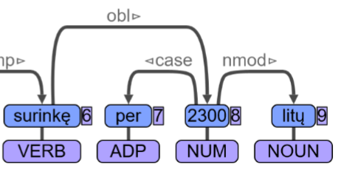
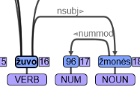
vv
1523 out of 2200 passengers.G died
gathered more than 2300 litas.pl.G
96 people.N died

Slide 15
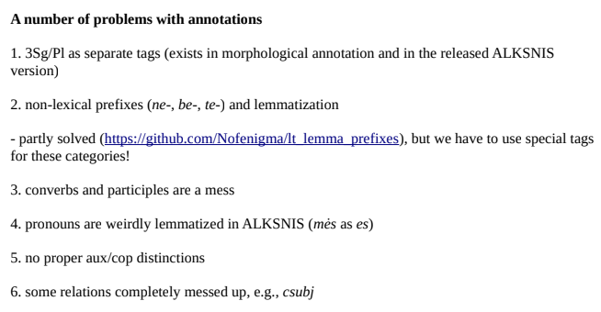
No relation Vocative
MWE are not separated
All abbreviations are marked as X

Slide 16
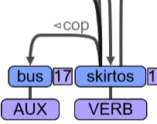
No AUX relation (to be+ passive participles)
will be dedicated

